Slide 1


Capstone Project -1
Play Store App Review Analysis
Team Members
Saniya Pirjade
Ankur Sarkar
Vivek Kumar
Ratneshwar Kumar
Pravin Chawan

Slide 2
Content
Introduction
Problem statement
Data cleaning / null value implementation
Data processing
Data exploration
Basic observation
Insights from data
Conclusion
Challenges and future
Reference

Slide 3
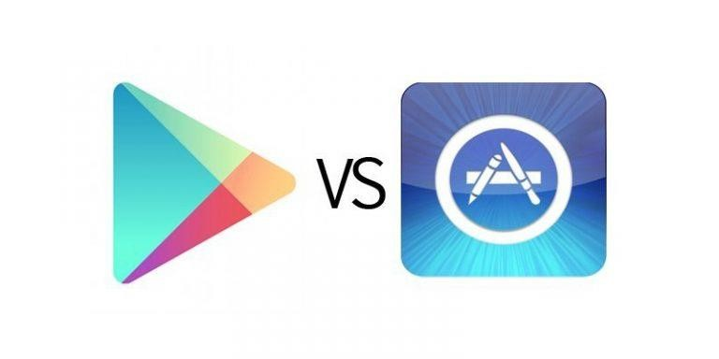
Introduction
The mobile industry is growing rapidly, and competition for apps has also grown significantly, so developers need to do enough research to make their apps successful.
The Google Play Store has been discovered to be the world's largest app market. It has been observed that although it generates more than double the downloads than the Apple App Store, it makes only half the money compared to the App Store.

Slide 4




Why we analyze the play store?
Mobile App Market is set to grow 20% by 2023
Android Apps comprise 75% of the Market Share. 85% share in
brazil,india,turkey.
What are some interesting patterns in user behavior related to app usage & feedback.
What makes an App popular? Can we predict how popular it’s going to be?

Slide 5
Problem Statement
For this project, we analyzed play store data from 2017-18, Google Play Store is the most used app store worldwide and also the global leader in this segment.
My main objective is to identify the key factors responsible for app success and user engagement.
Thousands of new apps in various categories are added to the Play Store on a regular basis.
We found the distribution of every app based on their size, installs, reviews, and much more.

Slide 6
Data cleaning
We remove the row from the rating column that contained the outlier, and the histogram becomes perfect.
We found the row number, which was 10472, and to replace all the null values so that the data frame looks nice and meaningful,
In the rating column, there were the maximum null values, so replace all the null values with the median of all the values of a particular column(which contains numeric data type values) in a data frame. We clean up all null values in the rating column.
We passed the rating column into that function as the variable. We also replaced the null values for the columns that have characteristic values with their modes. Then we found the price column and the install column.

Slide 7
Data Cleaning
The Google Play store dataset has 10,841 observations of data with fields.
data set 1) play store data 2) user reviews
List of fields:
App
Category
Rating
Reviews
Size
Installs
Type
Price
Content rating
Genres
Last updated
Current version
Android version
App
Translated review
Sentiment
Sentiment polarity
Sentiment subjectivity
Play store data
User
reviews

Slide 8
Data Cleaning (Contd..)
Understand the structure of the dataset and clean data before analysis
Finding Missing value in dataset.
Correct data type( STRING, INT, FLOAT, DATE)
Replace null value with aggregate function (mean, mode,median)
Checking outliers.

Slide 9
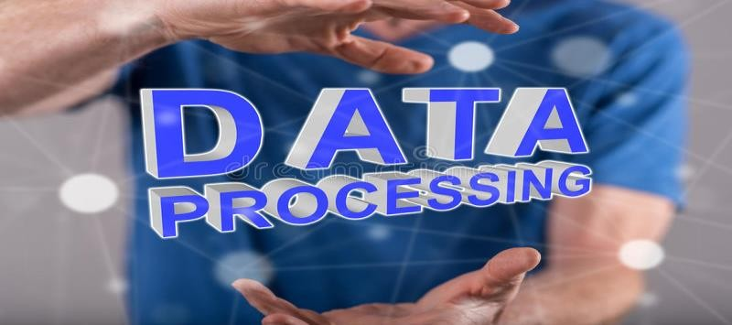
Data Processing
The dataset collected from the Play store is semi-structured or unstructured and contains significant superfluous data (defined as not contributing significant meaning). Some data types need to change in the required format, such as string, Int, float, Boolean and date time.
The size of apps needs to be converted into one measurement, KB or MB. Preprocessing includes various tasks, including stemming, lowercase conversion, units, punctuation, and excluding terms.

Slide 10
Data Visualization
We used a group by method to group the category column and made the objects for price, install, and review column as their respective sum, mean, and mean values.
We plotted graphs("Category vs. Installs," "Category vs. Pricing," and "Category vs. Reviews") with the help of matplotlib and the Pyplot library.

Slide 11
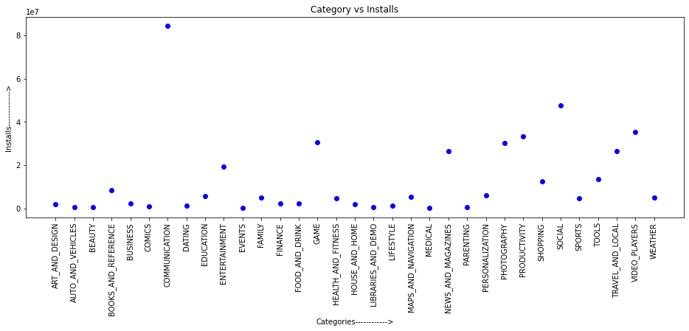
Data Visualization

Slide 12
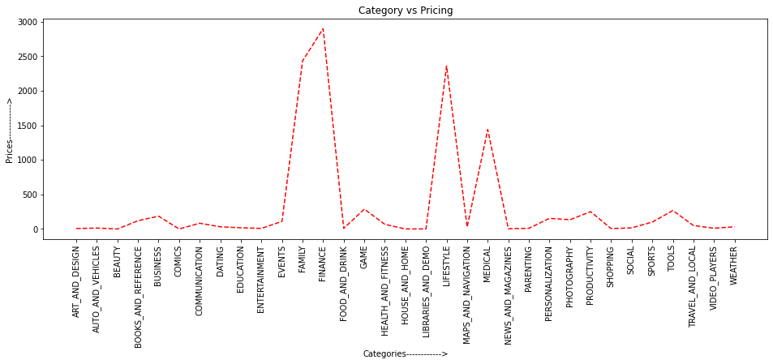
Fact

Slide 13
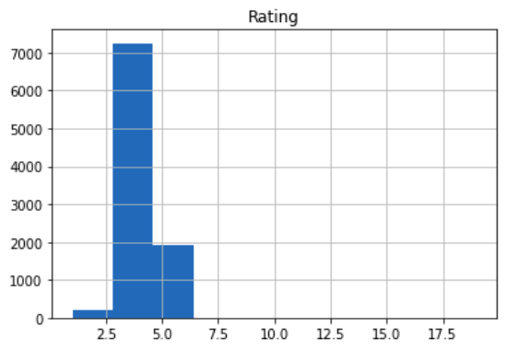
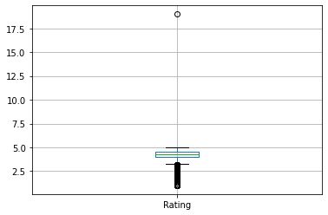
Rating of apps
Plotted histogram and box plot for rating.
Rating Distribution of app
Content Rating of app
Average rating above 4.2
Most apps come under this everyone

Slide 14
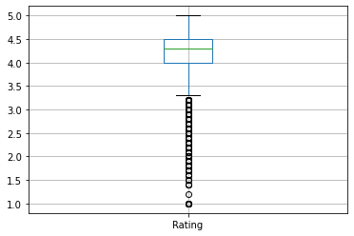
Cont..
The mean of the average ratings (excluding the NaN values) comes to be 4.2.
The median of the entries (excluding the NaN values) in the 'Rating' column comes to be 4.3. From this, we can say that 50% of the apps have an average rating of above 4.3 and the rest are below 4.3.

Slide 15
Basic observation
Below are some observation by doing data wrangling.
Average app rating | 4.30
Top five category highest average rating | 1)Events 2)Education 3)Arts and design 4)Parenting 5)Personalization
App with maximum reviews | Facebook
Top 5 app having highest reviews | 1)Face book 2) Subway surface 3)clash royal 4)Candy crush 5)UC-browser
Most expensive app | I’m rich

Slide 16
Insights from Data
World Cloud
Word Cloud is a data visualization technique used for representing text data in which
the size of each word indicates its frequency or importance.
Sentiment Polarity
The polarity of a sentiment measures how negative or positive the context is.
In the data that we have, the polarity ranges from -1 (most negative) to +1 (most positive).

Slide 17
CONCLUSION
The average rating we see of apps on the Google Play Store is 4.30.
Tools, entertainment, education, business, and medical are the top genres.
Family, Games, and Tools are the top three categories, each having a 1906, 926, and 829 app count.
Family and games apps are the most competitive category.

Slide 18
Cont..
Users download a given app more if it has been reviewed by a larger number of people.
Paid apps have a slightly higher number of favorable reviews than free apps.
Free apps get more negative and neutral feedback, suggesting a wider range of opinions.
The Face book app has the most reviews. While family and fitness are the most downloaded app.
More than half of users rate family, game, tools, entertainment and fitness apps positively. Apps for games and social media get mixed reviews, with 50 percent of positive and 50 percent of negative responses.

Slide 19
Challenges
The dataset contains NULL and NaN values.
The main task is to clean the data, followed by data processing.
Some data app names, etc., are in gibberish form and contain duplicates.
Future
In this project, we perform EDA and discover relationships with specific features using the sentiment of users.
Developers can use my work for their research purposes to make apps succeed.

Slide 20
Reference
The data set consists of Google Play Store applications and is taken from Almabetter.
Research paper based on play store analysis.
https://learn.almabetter.com/courses/take/team-capstone-projects/presentations/25003924-sample-project-presentation
https://github.com

Slide 21


